Slide 1
Sales Dashboard – Business Insights using Power BI
An Interactive Approach to Sales Data Analysis
Presented by: Nithya j

Slide 2
Project Overview
Objective: To design an interactive Power BI dashboard for analyzing sales data and extracting valuable business insights. It visualizes various Key Performance Indicators (KPIs) to help businesses understand critical sales trends.
Tools Used: Power BI Desktop
Dataset Source: Sales – Business Insights dataset from Kaggle

Slide 3
Dashboard Features
Total Sales & Revenue Trends – Analyze yearly and monthly sales performance.
Top-Selling Products – Identify the best-performing products.
Regional Sales Insights – Track sales performance across different locations.
Customer Purchase Behavior – Understand buying patterns and customer segmentation.
Profit & Loss Analysis – Evaluate business revenue and profitability.

Slide 4
Key Performance Indicators (KPIs)
Total Sales: 39.84
Total Profit: 9.6M
Profit Margin: 3.83M
Year-over-Year Growth: 2003 - 2005

Slide 5
Top-Selling Products
Visual: Bar chart listing top 5 products by sales.
Insight: Determine which products contribute most to revenue.

Slide 6
Sales Trends Over Time
Visual: Line chart showing monthly sales and profit trends.
Insight: Highlight peak sales periods and identify seasonal trends.

Slide 7
Customer Purchase Behavior
Visual: Segmentation chart of customer groups.
Insight: Understand customer demographics and purchasing patterns.

Slide 8
Interactivity Features
Slicers and Filters: Filter by date, region, product category, etc.
Drill-Down Capabilities: Navigate from summary to detailed views.
Navigation Menu: Switch between dashboard pages easily.

Slide 9
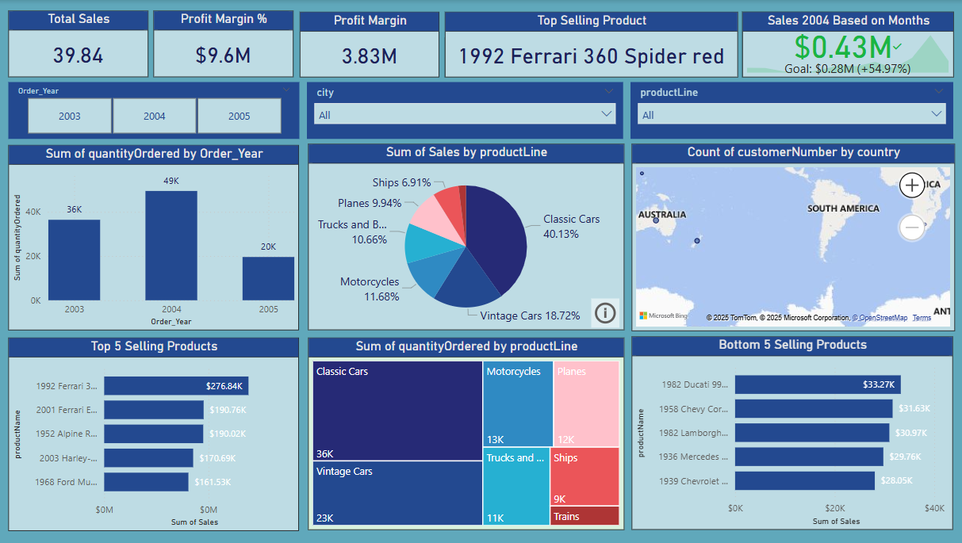
Dashboard view

Slide 10
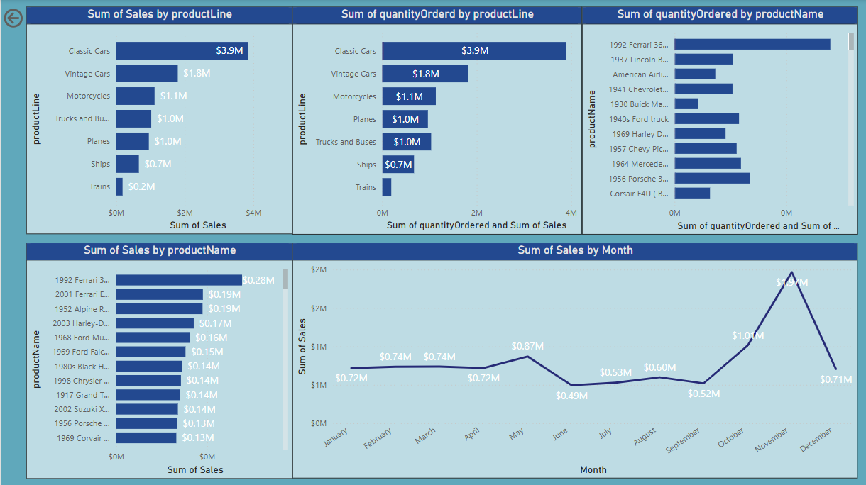

Slide 11
Conclusion
Identified best-selling products and high-performing regions.
Detected underperforming segments for potential improvement.
Gained visibility into customer buying behavior and sales trends.

Slide 12


